Slide 1
Reminder: Analog and Digital signals
Analog signal: a continuous signal of varying quantity which normally has a time varying feature
Digital signal: signal represented as discrete values and can only take one of a finite number of values.

Slide 2
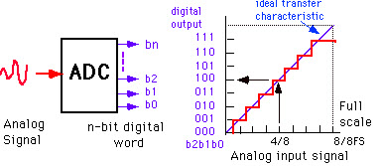
Review: ADCs (digital conversion)
Bit resolution
How much accuracy can the ADC convert from analog to digital?
3-bit ADC can provide 2³ divisions (8) in signal
8-bit ADC = 256 division
16-bit ADC = 65536

Slide 3
How many bits would it take to store DNA sequence information?
How much to store each DNA base?
For each 150-base read?
For 40,000,000 reads?

Slide 4
To store the sequences
Each DNA base (A, T, G, C) requires 2 bits of information:
A = 00
T = 01
G = 10
C = 11
For 150-base reads: 150 bases × 2 bits/base = 300 bits per read
40,000,000 reads × 300 bits = 12,000,000,000 bits
12,000,000,000 bits ÷ 8 bits/byte = 1,500,000,000 bytes
1,500,000,000 bytes ÷ 1,000 bytes/KB = 1,500,000,000 KB
1,500,000,000 KB = 1.5 GB
Notes:
This calculation represents the theoretical minimum storage required for just the sequence data in its most compressed form. In practice, sequencing data files (like FASTQ) include quality scores for each base and other metadata, which substantially increases the actual storage requirements by 4-8 times these values.
The correct conversion uses powers of 1,024 (2^10) rather than powers of 1,000 when moving between binary units of storage (bytes → kilobytes → megabytes → gigabytes).

Slide 5
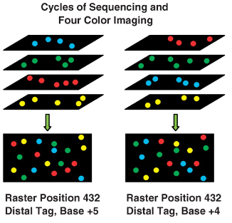
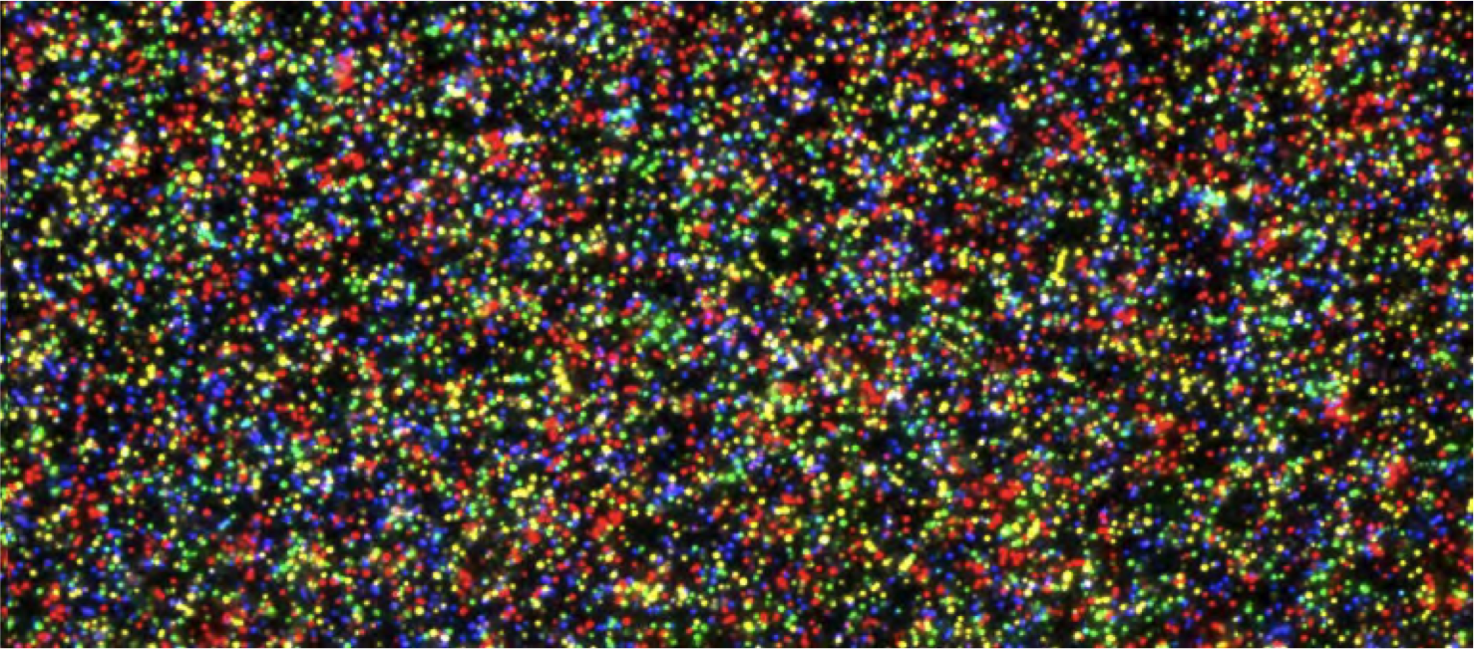
Other types of analog to digital conversion in Omics?
= X reads
3-bit ADC can provide 2³ divisions (8) in signal
8-bit ADC = 256 division
16-bit ADC = 65,536
24-bit ADC = 16,777,216
32-bit ADC = 4,294,967,296

Slide 6
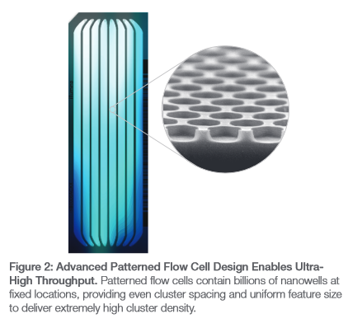
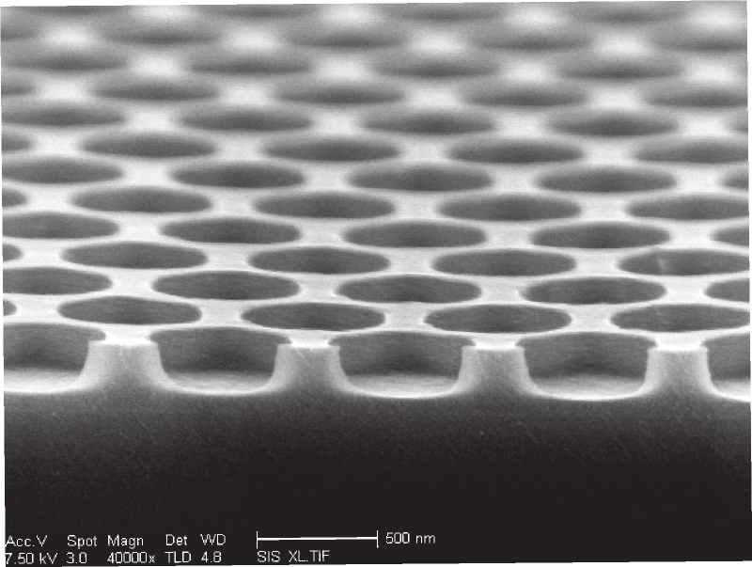
In practice: Today … wells are at fixed locations
Each well is basically 1-bit of quantitative information

Slide 7
Maximum “Count” Per Read is 1
1 bit per read
40,000,000 reads × 1 bit = 40,000,000 bits
40,000,000 bits ÷ 8 bits/byte = 5,000,000 bytes
5,000,000 bytes ÷ 1,000 bytes/KB = 5,000 KB
5000 ÷ 1,000 KB/MB = 5 MB

Slide 8
Quantitative Bit Resolution for RNA-Seq = Reads
Scenario:
40 million reads
~10,000 unique molecular species
Mean mRNA molecule copy per cell = 5
Dynamic range of mRNA molecules per cell 1-100
Questions:
Is 40 million reads enough?
If yes, why?
If no, what would be a good number?
Notes:
40,000,000 reads / 10,000 molecular species = ~4000 reads on average per molecular species
400,000 mRNA molecules per cell … so ~100 reads for mRNA at the single copy level.

Slide 9
Quantitative Bit Resolution for RNA-Seq = Reads
Scenario:
40 million reads
~10,000 unique molecular species
Mean mRNA molecule copy per cell = 50,000
Dynamic range mRNA molecules per cell 10 to 1 million
Questions:
Is 40 million reads enough?
If yes, why?
If no, what would be a good number?
Notes:
40,000,000 reads / 10,000 molecular species = ~4000 reads on average per molecular species
4,000,000,000 molecules … 0.01 read for molecule.

Slide 10
Selectivity vs Sensitivity

Slide 11
Fluorescence Advantage
Absorption measurements detect a small change in a large signal (the difference between incident light and transmitted light)
Fluorescence measurements detect a small signal against a dark background (essentially "zero" background)
Chemical noise/background is a major limitation.

Slide 12
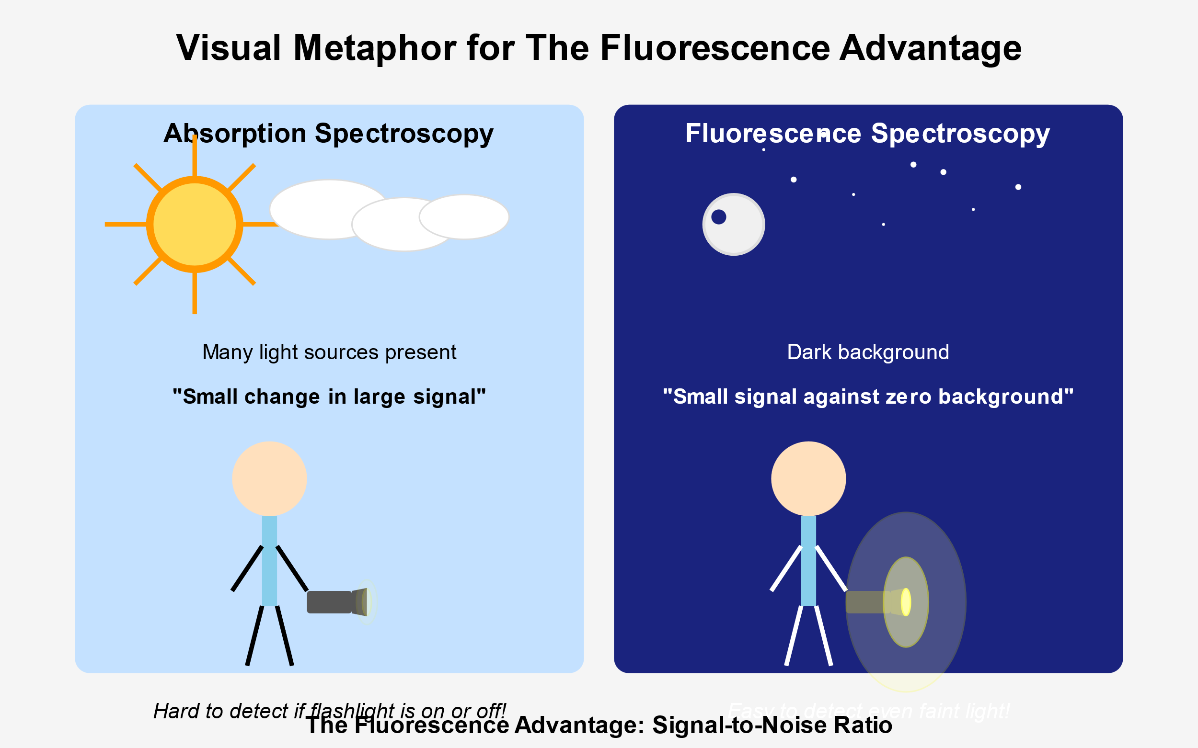

Slide 13
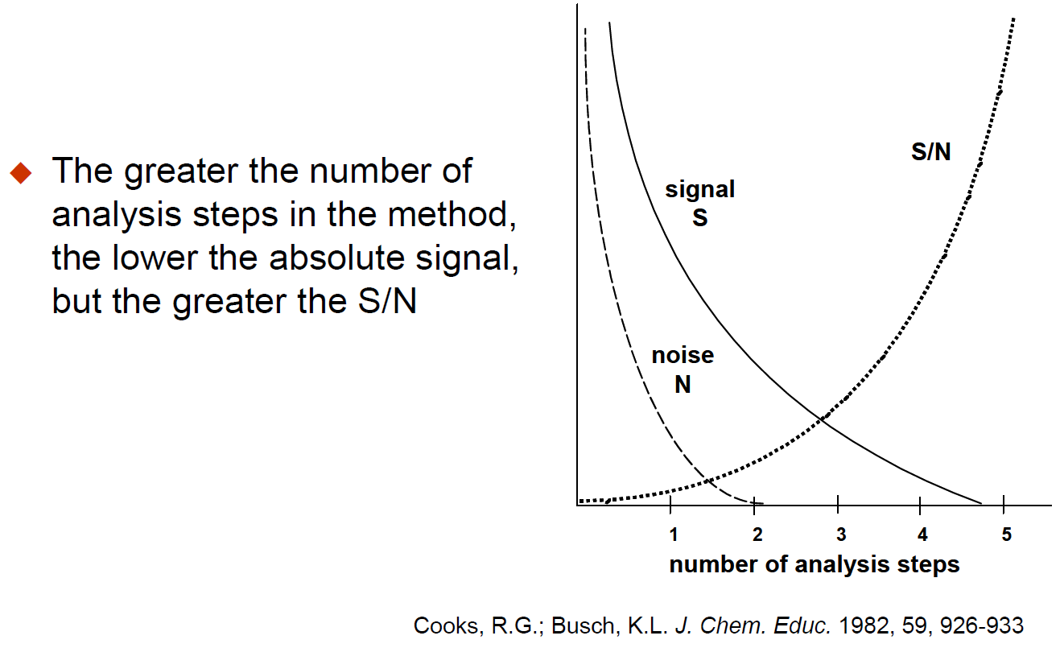

Slide 14
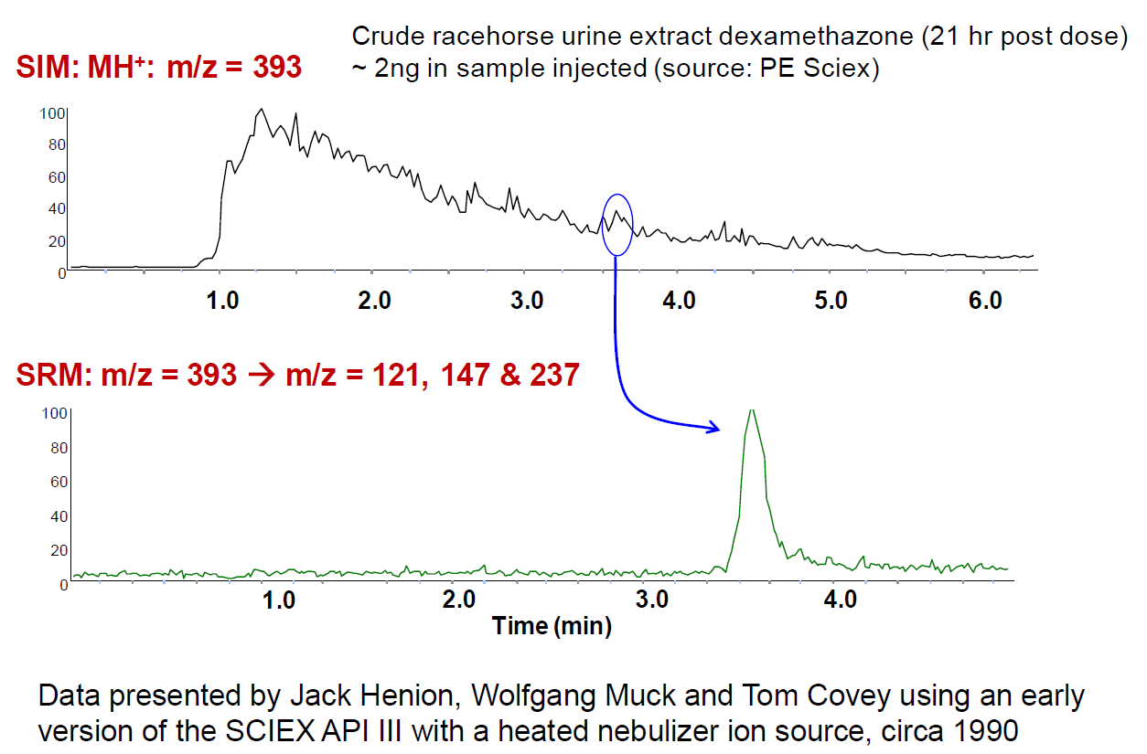

Slide 15
Quantitative Analysis 101
What does it mean to be quantitative?

Slide 16
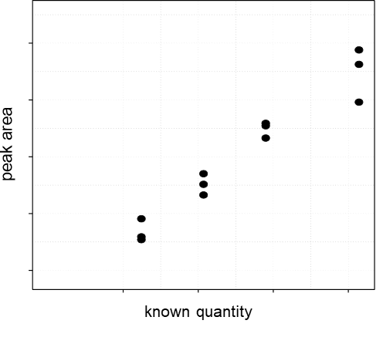
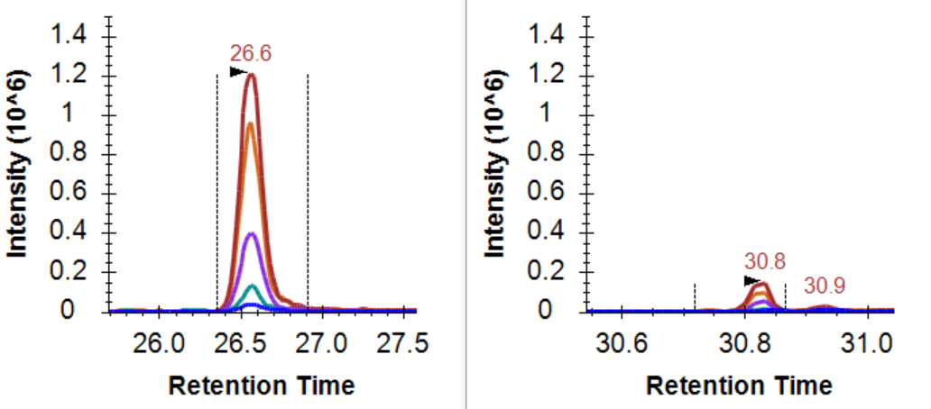
The change in signal should reflect the change in quantity

Slide 17
Quantitative Analysis 101
ULOQ
Linear Dynamic Range
Measured Intensity (Area)
LOD
LLOQ
Amount (moles)
LOD: Limit of Detection
LLOQ: Lower Limit of Quantitation
ULOQ: Upper Limit of Quantitation

Slide 18
Quantitative Analysis 101: Using an Internal Std
ULOQ
Linear Dynamic Range
Intensity Ratio (Area Ratio)
LOD
LLOQ
Amount (moles)
LOD: Limit of Detection
LLOQ: Lower Limit of Quantitation
ULOQ: Upper Limit of Quantitation

Slide 19
Quantitative Analysis 101
What does it mean to be quantitative?
What does signal calibration mean?

Slide 20
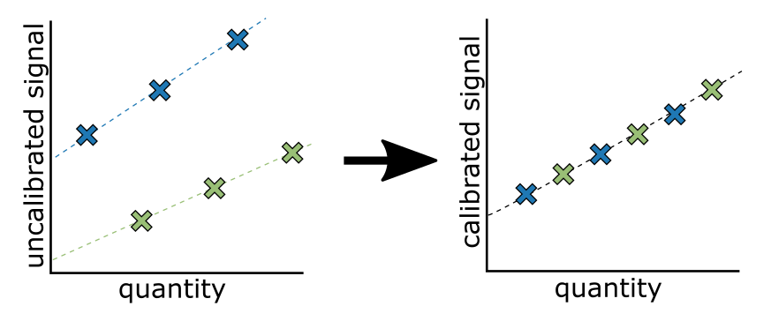
Measurements on different platforms are not measured on the same scale

Slide 21
Between Batch/Platform/Lab Signal Calibration
Purpose of signal calibration
Placing signal on the same scale
Often the scale is arbitrary
Kilogram = mass of a liter of water at freezing point
Meter = 1/10,000,000 the distance from the equator to the north pole
Pee dee belomnite (PDB) = reference for 13C, fossil found in Peedee Formation in South Carolina
Standard mean ocean water (SMOW) = reference for 18O, arbitrary mix of distilled water from different regions of the world.

Slide 22
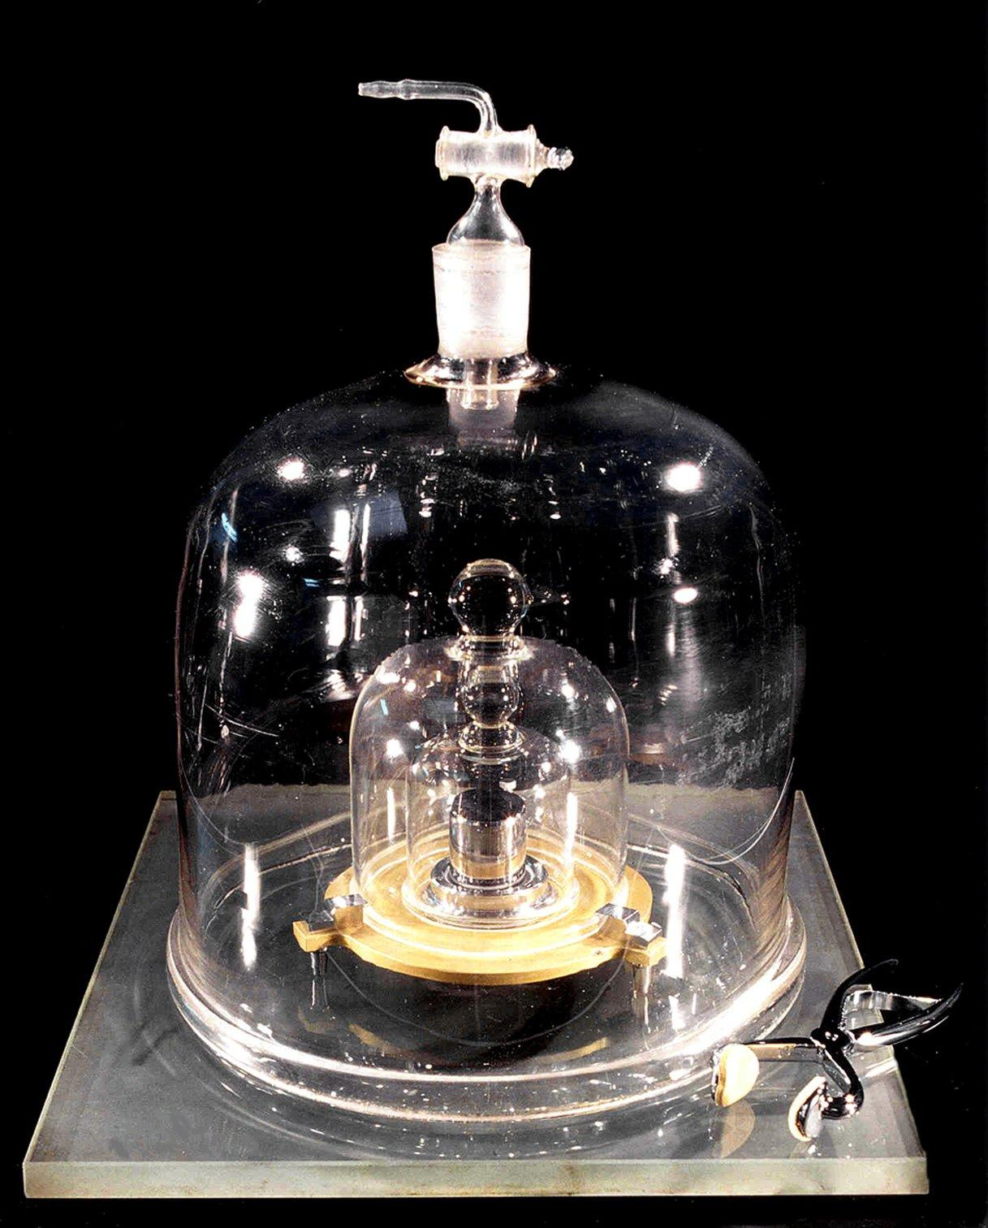
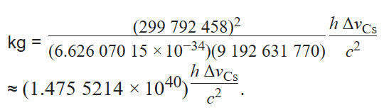
Physical Kilogram Standard
Platinum-iridium cylinder, known as the International Prototype of the Kilogram (IPK)
Used as the reference from 1889 to 2019.
This cylinder is approximately golf ball-sized and machined from a platinum-iridium alloy.
Stored under lock and key in France. In 2019, the kilogram was redefined using fundamental constants of nature, and the IPK is no longer the official standard.
Now:
Defined using Planck’s constant and the speed of light

Slide 23
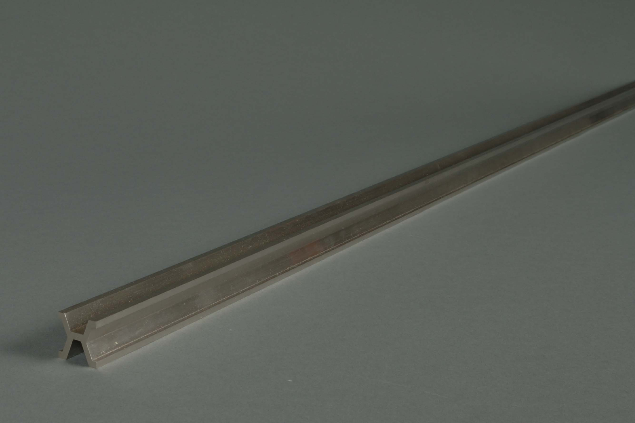
Meter Reference Similar
NIST Meter Bar 27
No. 27 became the U.S. reference standard for all length measurements. It remained so until 1960

Slide 24
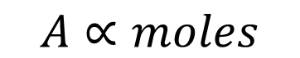
Use of calibration curve to convert signal to quantity
Analyte (m/z = M)
$$A∝moles$$
M
A
Intensity
Intensity
m/z
time
Measured Signal (Area)
Known Amount
Where: k_{i}= is the slope of the standard curve A_{b} ≈ 0 Area from a blank

Slide 25
What you calibrate against is important

Slide 26
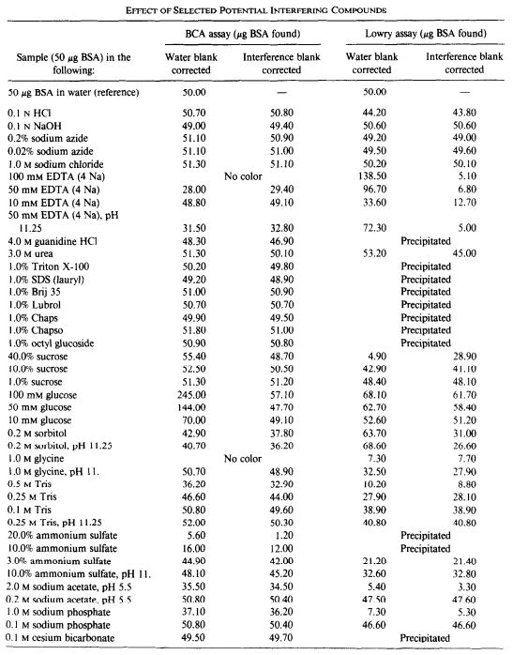
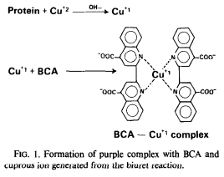
What you calibrate against is important
Bicinchoninic acid (BCA) is the current standard for measuring protein abundance.

Slide 27
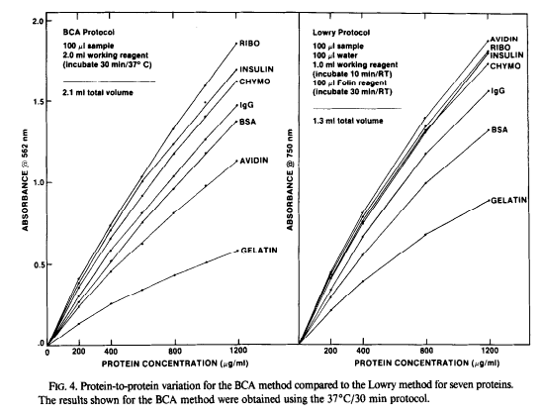
What you calibrate against is important
Smith et al., Anal Biochem 1985

Slide 28
What is the difference between relative and absolute quantitation?

Slide 29
What is the difference between a “differential” and a “quantitative” measurement?

Slide 30
What does it mean if these are the two points?
ULOQ
Linear Dynamic Range
Measured Intensity (Area)
LOD
LLOQ
Amount (moles)
LOD: Limit of Detection
LLOQ: Lower Limit of Quantitation
ULOQ: Upper Limit of Quantitation

Slide 31
Major Quantitative Figures of Merit
LOD – Limit of Detection
LLOQ – Limit of Quantitation
Precision
Within batch/day
Between batch/day

Slide 32
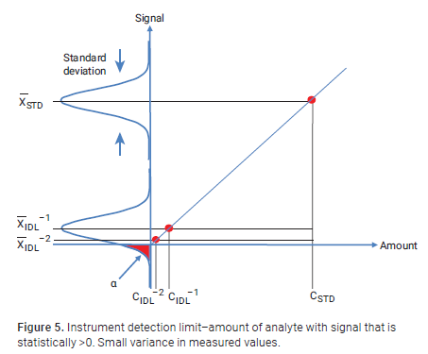
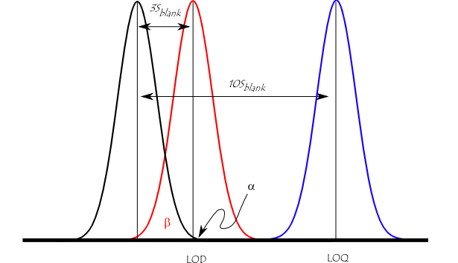
Limit of detection
Is a signal statistically different from a blank?

Slide 33

Limit of Quantitation
Does the change in quantity reflect the change in signal?
The limit of quantitation (LOQ; also referred to as the lower limit of the measuring interval (LLMI)) is defined by the Clinical and Laboratory Standards Institute as ″the lowest measurand concentration at which all defined performance characteristics of the measurement procedure are met.″
Our lab often chooses for LLOQ:
Must be >LOD
Must have a coefficient of variation <20% (aka S/N >5)

Slide 34
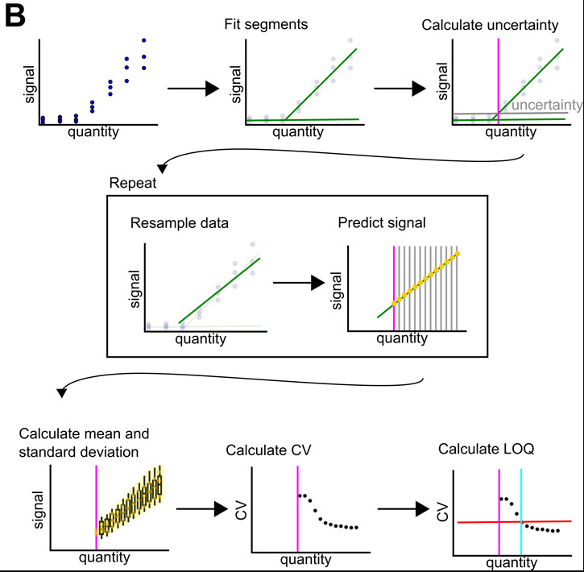
Limit of Quantitation
Does the change in quantity reflect the change in signal?
The limit of quantitation (LOQ; also referred to as the lower limit of the measuring interval (LLMI)) is defined by the Clinical and Laboratory Standards Institute as ″the lowest measurand concentration at which all defined performance characteristics of the measurement procedure are met.″

Slide 35
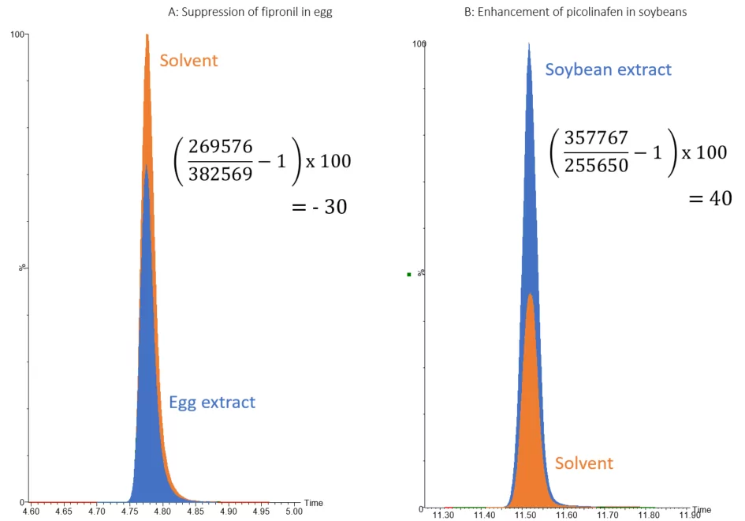
Matrix Effects in Quantitation

Slide 36
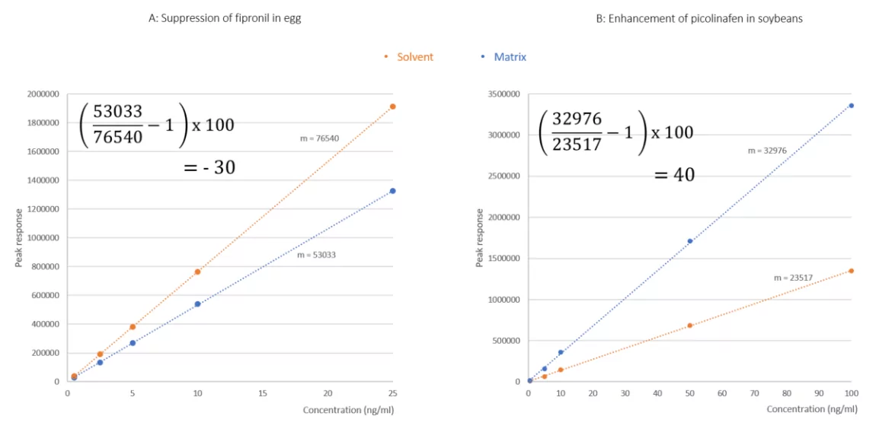
Matrix Effects in Quantitation

Slide 37
Method of Standard Addition
Can’t assess Limit of Quantification. Can only assess whether the sample us above the LOQ

Slide 38
Mixing two samples of extreme conditions
Assume that you have a healthy and a disease cohort.
You can take a pool of the healthy and a pool of the disease to demonstrate that the measurement is linear between the two conditions
Example
100% condition A
80% condition A, 20% condition B
50% condition A, 50% condition B
20% condition A, 80% condition B
100% condition B

